Slide 1
Software product management
Overview
Joydeep Barman

Slide 2
Contents
Evolution of product organizations
Why products fail?
What do best product teams do?
Product management: Relationship with rest of the company
Product Lifecycle
Technology adoption lifecycle
Journey of some product companies
Multi-faceted role of a Product manager

Slide 3
Evolution of product organizations
A product organization goes through the following stages:
Startup
Growth stage
Enterprise
Let us see what are the characteristics of each stage…

Slide 4
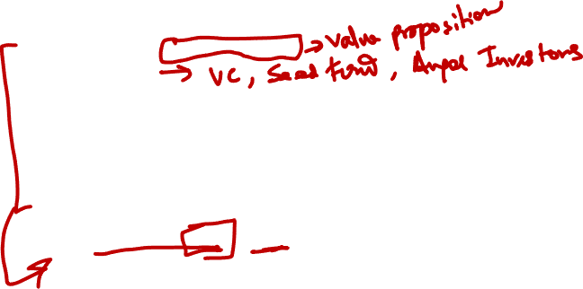
Startup stage
Trying to achieve product-market fit,
Limited funding,
Learns quickly
Little bureaucracy,
Many fail,
Those that succeed are good at product discovery,
Risky but rewarding if things go well.
Examples: WhiteHat Jr, Simpl as failed startups
Many recent AI companies

Slide 5
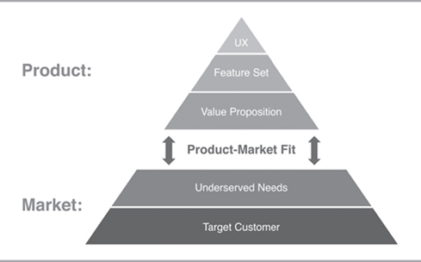
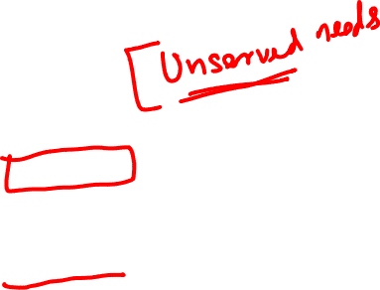
Product-Market fit concept

Slide 6


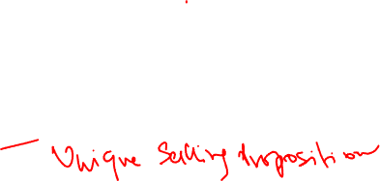
Startup stage examples
WhiteHat Jr
Founded in 2018
Offers coding & AI courses to children aged 6 to 14 years.
Aims to empower children to become creators
BYJU‘s acquired it for $300 million
It is now winding down
Simpl
Started 2016
Online payment method that allows a consumer to buy now and pay later
Digitalizing the old Khata system of payment to grocer, milkman, etc.
Simpl under-writes customer payments based on machine learning
USP: Transparent financial services and single click payment
Currently non-operational due to RBI directive

Slide 7
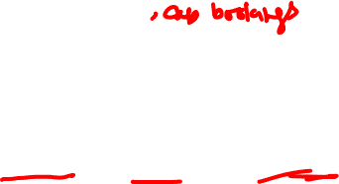
Growth stage
Scale up – more customers
Replicate earlier successes with new, adjacent products and services – MakeMyTrip flight, train, hotel
Technology infrastructure is stretched (Netflix during the growth stage)
There is technical debt (Amazon monolithic to microservices)
Goes for IPO or gets sold (MakeMyTrip IPO, WhatsApp sold to Facebook)
Examples: Bounce (2016), Postman (2014), KissFlow (2013).

Slide 8
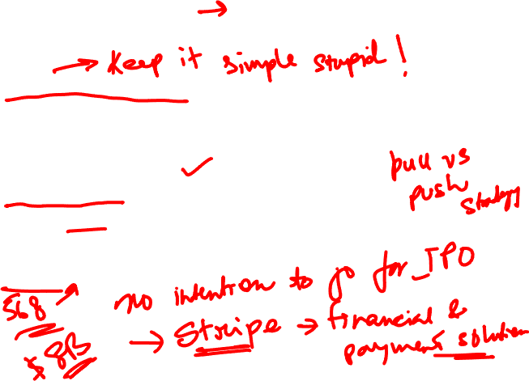
Growth stage example
Kissflow
Business Process management software
Self-service setup / configuration
50 process templates to choose from – employee on-boarding, travel reimbursement
Strong after sales support
Product led growth - leading to pull rather than push
10,000-plus clients, including biggies like Airbus, Danone, Michelin and Pepsi
Competitors - Pega, Appian, Outsystems
500+ employees

Slide 9
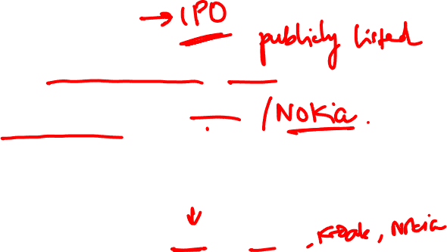
Enterprise stage
Focus is on consistent product innovation, stay ahead
But many companies are satisfied with leveraging the value created and brand created, leading to slow death (ex. Kodak)
They work hard to protect what they have created and less on new ventures & initiatives
There is lack of vision, increased bureaucracy, resorts to acquisitions or creating separate innovation centers to incubate new business or products (example Cisco).
Companies that failed to innovate: Xerox, AoL, Motorola
Strong enterprise companies: Adobe, Amazon, Apple, Meta, Google, and Netflix

Slide 10



Enterprise stage: Examples of consistent innovation
Netflix | Amazon | Meta
DVD movie sales DVD rentals Online booking of DVD, delivered via Post Streaming video In house production of serials and movies Movie / Serial Award function (akin to Oscar) | Books Electronics, Others Recommendation feature Amazon Prime Alexa Kindle AWS Firestick Amazon Pay | Wall & messaging News Feed - streams friend’s activity Sell stuff to other Facebookers Tagging and attachments ‘Like’ button Timeline feature Buys Instagram, WhatsApp

Slide 11

Why products fail?
Most companies start with ideas generated internally or got from existing or potential customers.
  Example: HP’s AI‐enabling technology on a low‐cost, general‐purpose workstation developed by Marty Cagan & team (1980s), DB designer – I worked on (1989)
Based on these ideas they create a business case, roadmap, build the product and deploy
It is then that they realize that there are no takers
More examples of failed products:
  Apple Watch Gold edition
  Google+ social media
  The Daily - Digital newspaper in collaboration with Apple

Slide 12
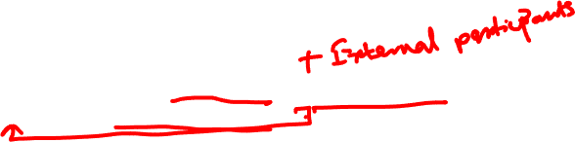
What do best product teams do?
Tackle risks early
Define and design products collaboratively – PM, Designer, Engineering
Solve problems, not just implement features

Slide 13
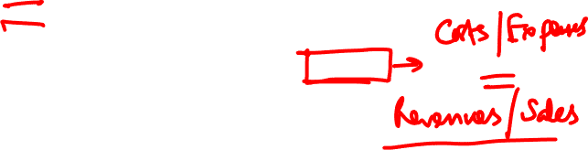
Tackle risks early
There are 4 types of risks:
Value – Does customer find value in the product
Usability – Is the product easy to use
Feasibility – Is the product technically feasible to build
Viability - Will business be viable, can we break even

Slide 14
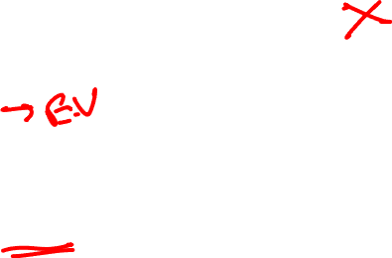
Tackle risks early - Example
Bounce, AirBnB, Slack
Bounce spotted an opportunity in Bangalore: Provide scooter to reach the nearest metro station
Bounce experimented their concept with a few scooters to determine value. Once the demand / value was established, they expanded
AirBnB rented their house to test value. A conference was being held in their city and people would be looking for accommodation
Slack requested friends and cajoled 6-10 companies, to use their product and give feedback to determine usefulness / value and usability and improved the product based on user feedback.

Slide 15
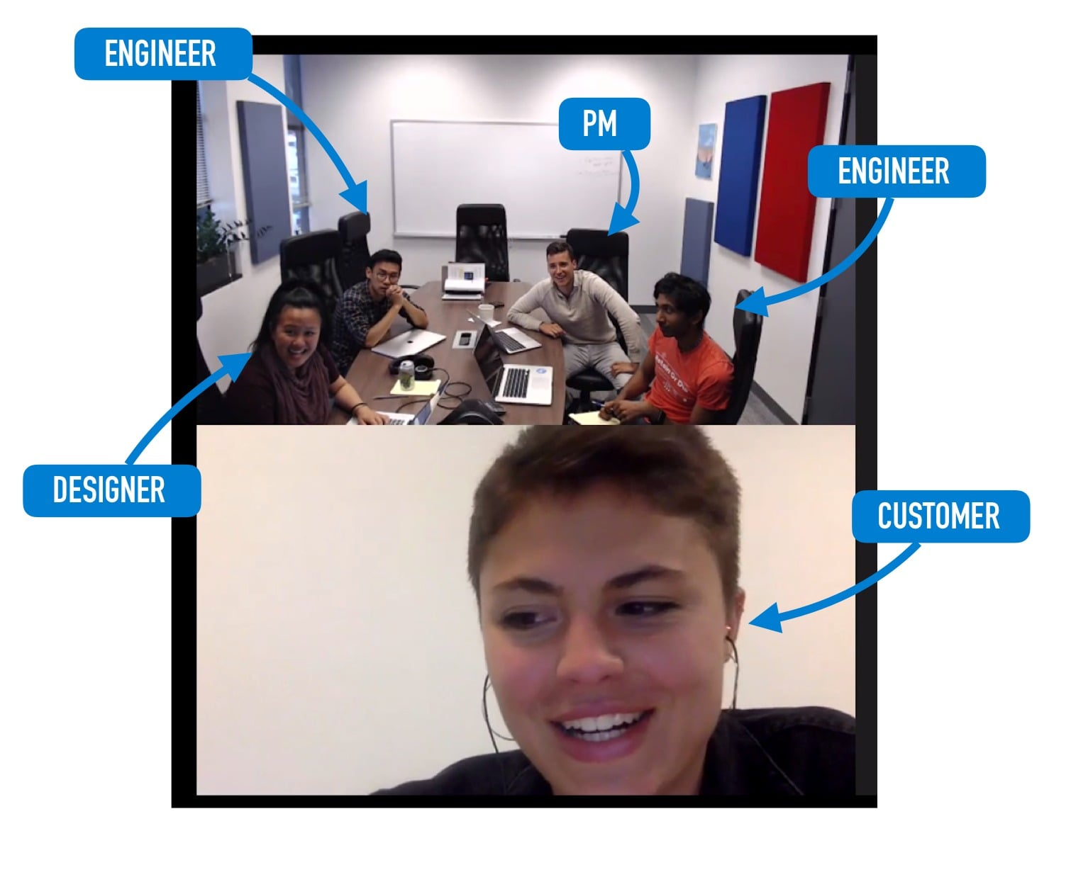
Define and design products collaboratively
Product, design & engineering work side by side in a give-and-take manner
Leads to better solution ideas & higher ownership
Example: Amplitude
A product analytics s/w
Engineers stay connected with customers by participating in client calls

Slide 16
Solve problems, not just implement features
Example: Kissflow
Workflow automation improves employee productivity
Provides 50 ready-to-use workflows from travel reimbursements to employee on-boarding
Easy diagramming helps model a company’s process just as it appears in the business manager’s mind.

Slide 17
Solve problems, not just implement features
Example: Wobot Intelligence
Helps organizations in the Food, Retail, and Manufacturing sectors to reduce risk of non-compliance & pilferage
Has process compliance modules like hygiene, workforce & workplace safety, customer SOPs, and more
Uses deep learning Video Analytics to identify people, objects and their activities
Customers - IRCTC, Rebel Foods, CureFit, Kitopi, Travel Food Services, Burger Singh, G4S, Max Estates, Blue Tokai, Apparel Group and Smartworks

Slide 18
Solve problems, not just implement features - Example
Example: Logically
Detects fake news & inaccurate news using AI & ML
Finds out who is spreading misinformation to enable authorities to take action
Examples:
  Detected misinformation during the death of a Bollywood actor Sushant Singh, during conflict with China in Ladakh, and during the Kashmir issue with Pakistan.
  Detected bots originating in Pakistan that were interfering with geopolitical and sensitive issues within India
Customers: Indian Election Commission, Pharma companies to prevent anti-vaccine information, Mysore Police

Slide 19
Product management: Relationship with rest of the company
Development team relies on product management to define a plan and write user stories, requirements, and acceptance
Marketing team relies on Product management for product information, value proposition definitions. They collaborate to define product position, launch product, define Go-to-market strategy
Sales team relies on Product management for demo cases, answering detailed inquiries, and helping to close deals.
Finance and Product rely on each other to build the business through determining pricing, margins, discounting, and so forth.

Slide 20
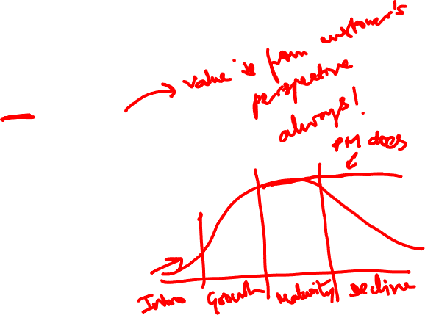
Product lifecycle
Determine your target customers
Identify underserved customer needs
Define your Value Proposition
Assess value through customer interaction
Specify your Minimum Viable Product (MVP)
Create your MVP prototype
Test your MVP with customers
Iterate
Launch product & support
Grow & build adjacent products
End of life

Slide 21
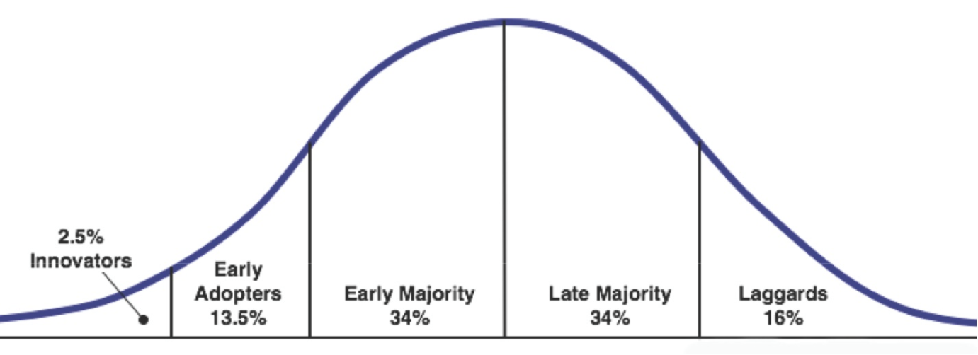
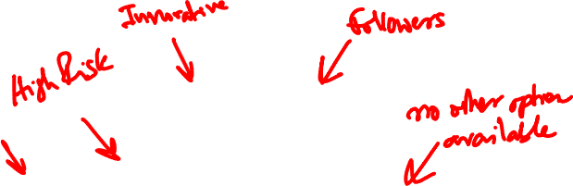
Technology adoption lifecycle
Products using new technology such as AI, NLP, Blockchain, Robotics are adopted gradually

Slide 22
Technology adoption lifecycle…
Innovators are the first to get interested on new products and novelties. They even accept incomplete or defective products just for the pleasure of being the first ones to use this new product.
Early adopters, also known as visionaries or enthusiasts, who accept the risks of testing a new product, but not for the pleasure of coming first but because they see the potential in it. Usually, they are influencers within organizations and communities in which they participate.
  IBM Watson was adopted by a Memorial Sloan–Kettering Cancer Center, Cleaveland Clinic, MD Andersen Cancer Center, to get advise on Cancer
Early majority, also called pragmatic, buy new products only after they got references.
  Manipal Hospital Bangalore, Georgia tech teaching assistant, H&R Block for tax preparation, Several startups use it for developing cognitive apps
Late majority are the conservatives, in other words, those who buy only after the price has dropped substantially. Example late majority users of SalesForce
Laggards, who only buy a new product if this is the only option available.

Slide 23

Technology adoption lifecycle…
Example:
IBM Watson & Robotic surgery (Da Vinci) used by one or 2 hospitals.
In 1999 Salesforce.com was the first to use Cloud to offer applications on the Cloud. 3 years later the industry grew massively with video, music and other media being hosted and delivered online.
https://www.scality.com/solved/the-history-of-cloud-computing/

Slide 24
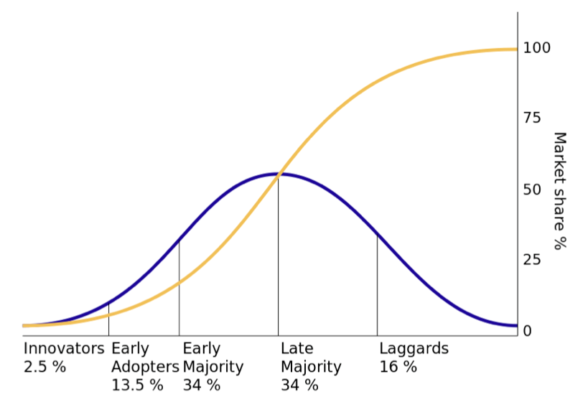
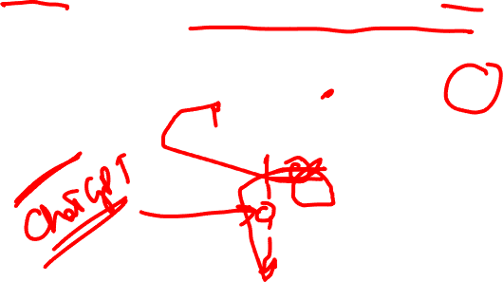
Technology adoption lifecycle…
S-curve: By calculating the integral (who remembers the calculus classes?) we can obtain the famous S-shaped technology adoption curve.

Slide 25
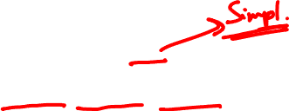
Multi-faceted role of a Product manager
Deep knowledge of customer, your business, market & industry
  Nium - money transfer to foreign countries
  Had deep knowledge of money transfer markets in Singapore,, Indonesia, Japan, etc.
  Had good knowledge of forex – how it works, who are the players, banking
Engage with customers, understand their business, process, pain points
  Slack understood the collaboration needs of teams
  Twilio understood the messaging needs of companies
  Wobot understood the process compliance needs of food, pharma, retail industries
Prioritize ideas, features & projects
  Slack focused on Search, synchronization, file sharing
Collaborate with Design, Engineering, Marketing, Legal, Finance
Recruit, Train & develop the product team
Manage upward & outward: Tell a story, sell a vision, get funding
Align & focus the organization

Slide 28
Let’s hear it from some Product Managers
Please watch the session recording. Video had to be removed due to file size limitations.
Adapted from: Introduction to Software Product Management, University of Alberta, Canada

Slide 29
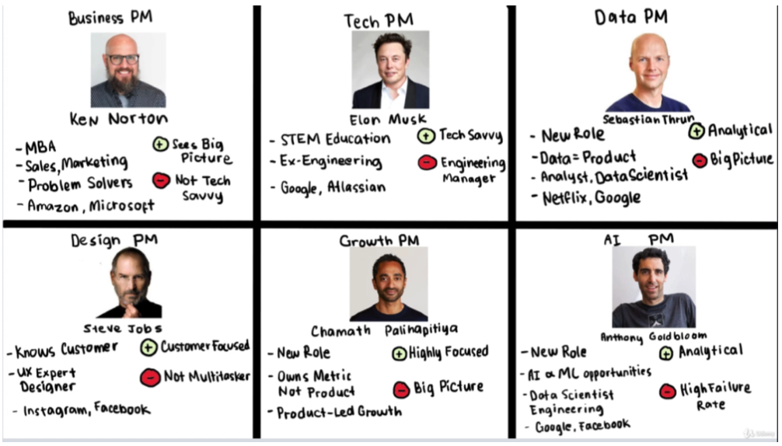
Types of Product Managers

Slide 30













Exercise: Choose your product!
Tech Product
Existing or new
Realistic role

Slide 31
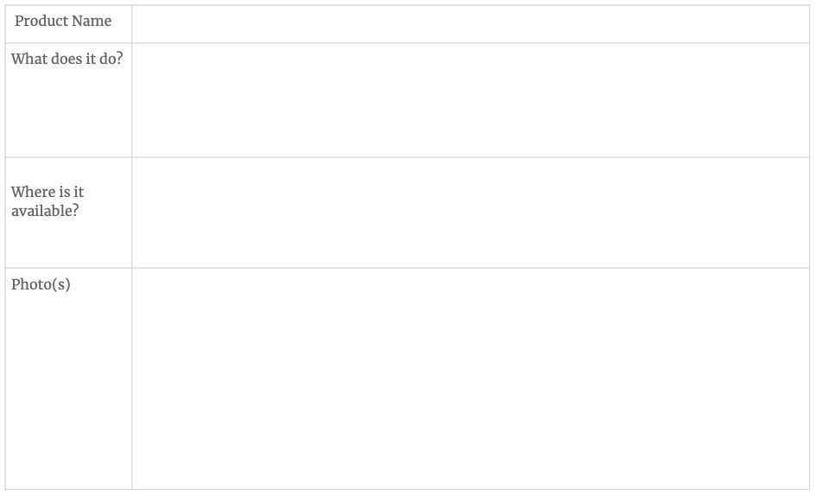
Exercise: Choose your product!

Slide 32
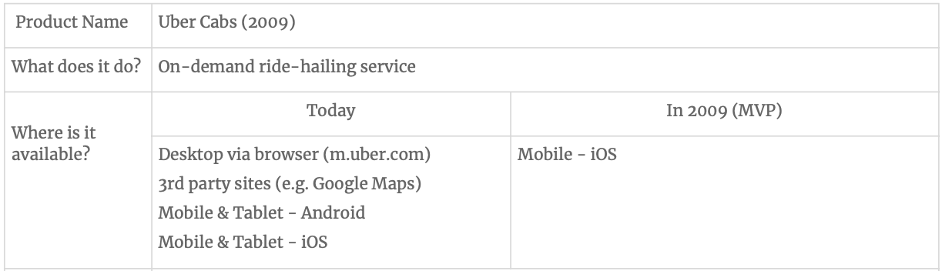
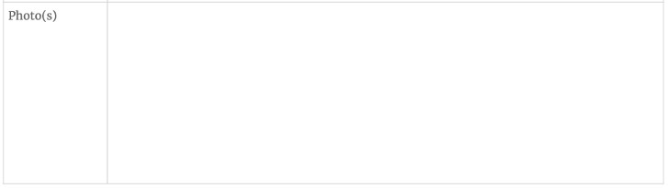
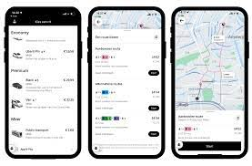
Exercise: Choose your product!

Slide 33
Journey of some product companies: Case Study
Study the journey of Netflix and identify:
Key milestones
Challenges faced
What they did right and what they did wrong
Key Product management learnings
Case Study: https://www.businessmodelsinc.com/en/inspiration/blogs/netflix-how-a-dvd-rental-company-changed-the-way-we-spend-our-free-time

Slide 34
Thank You!

